Slide 1
Git Advanced Commands

Slide 2

Basic Git commands
git stash
git reset
git revert
git log
git diff
git config
git fetch
git blame
git

Slide 3
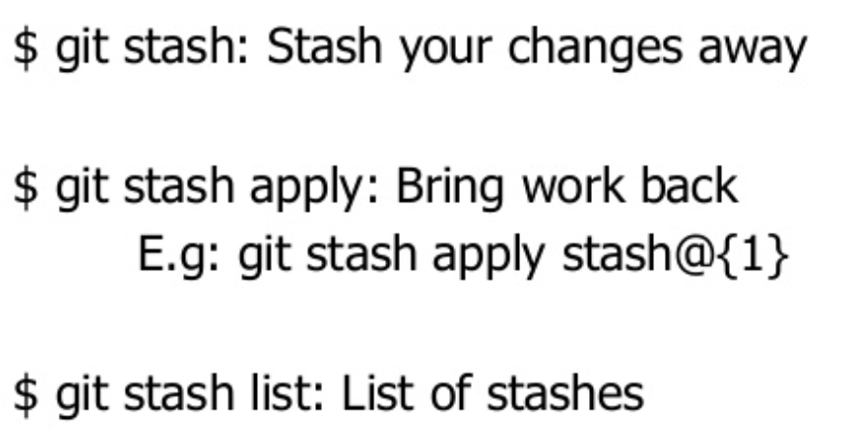
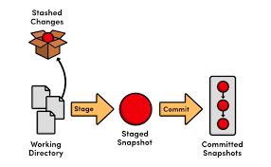
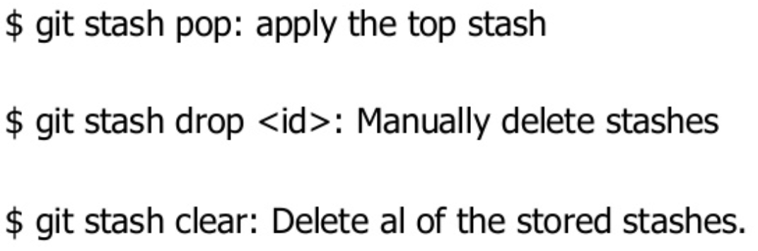
stash
Temporary shelves the changes
Handy if you need to quickly switch context & work on something else
Notes:
https://git-scm.com/docs/git-stash

Slide 4
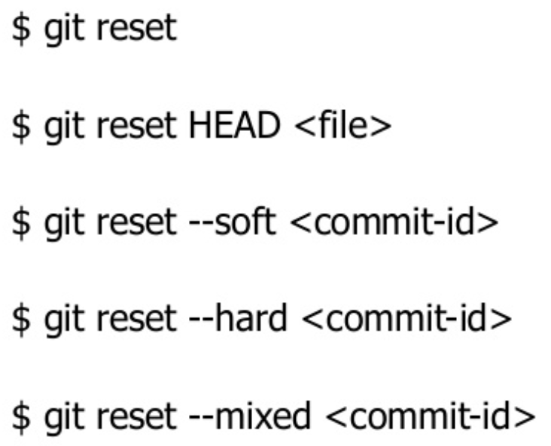
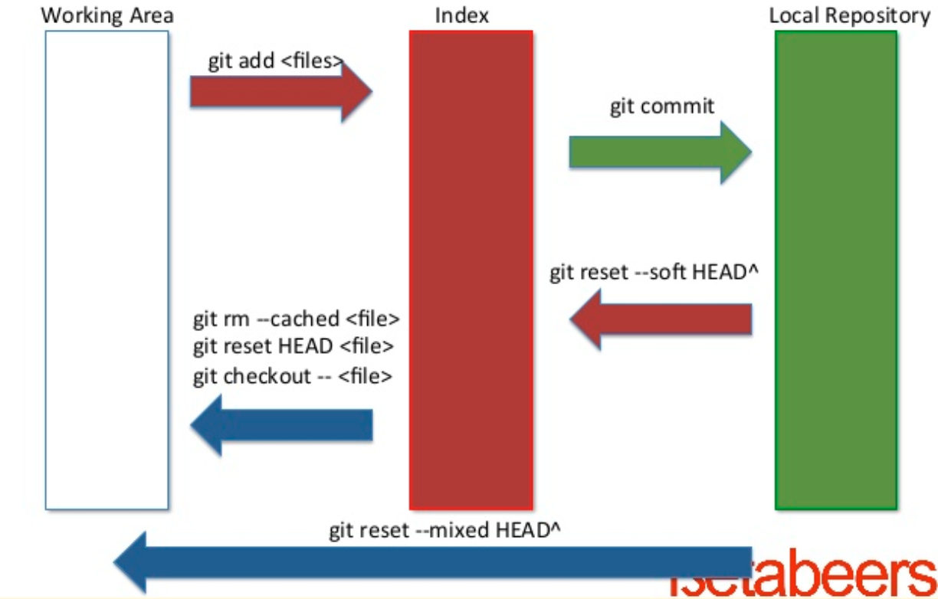
reset
It is a permanent undo
When you do undo with `reset`, there is no way to retrieve the original copy
Notes:
https://git-scm.com/docs/git-stash

Slide 5
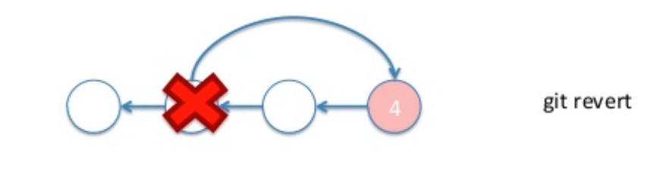
revert
This creates a new commit that undergoes the changes from a previous commit
It adds new history to the project
Notes:
https://git-scm.com/docs/git-stash

Slide 6
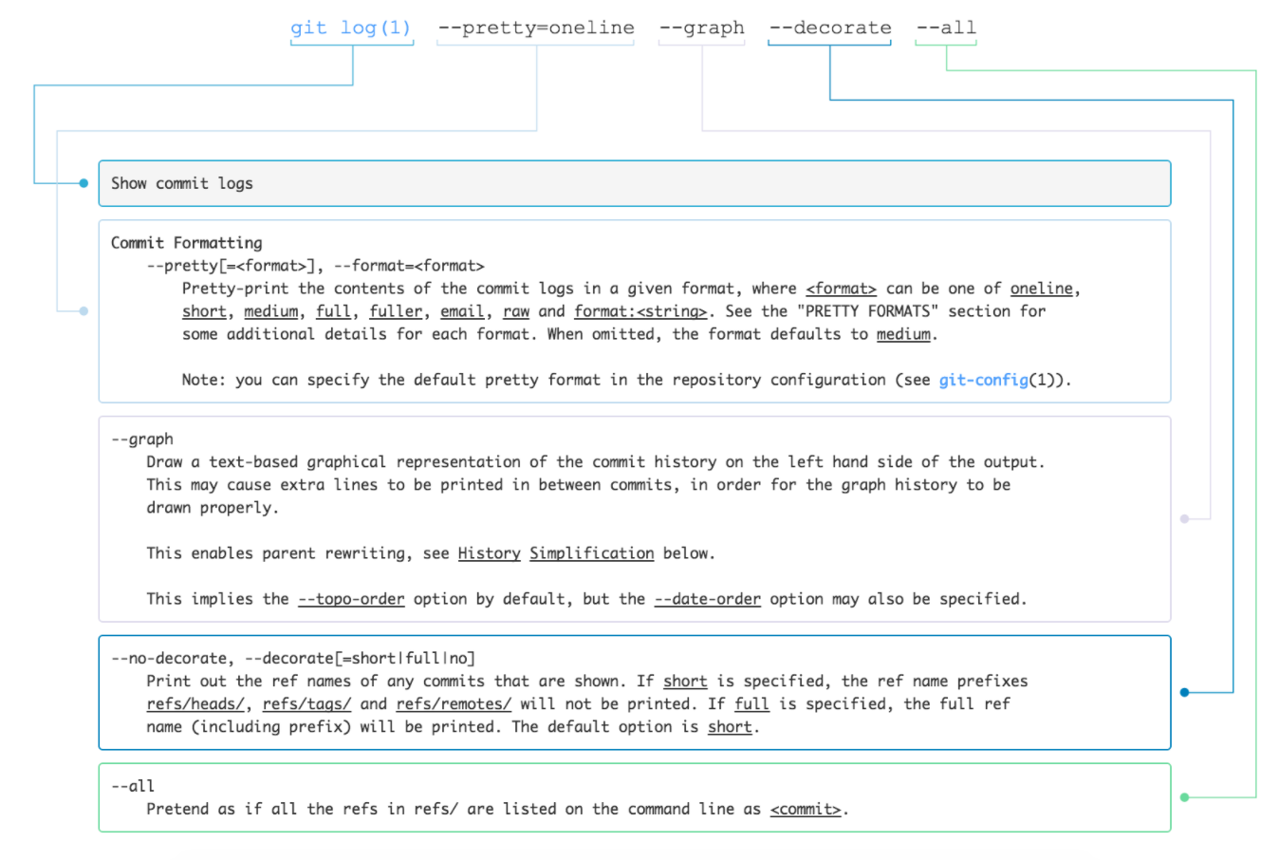
log
Records your changes
Can use --graph for representing the branch structure of the commit history
You can filter the log output by - Author, Date, Amount, Message, File, Content etc
Notes:
https://git-scm.com/docs/git-stash

Slide 7
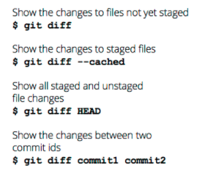
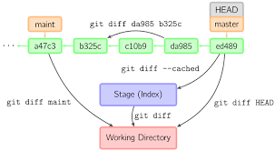
diff
Show changes between working tree and index
git diff <filename>
Notes:
https://git-scm.com/docs/git-stash

Slide 8
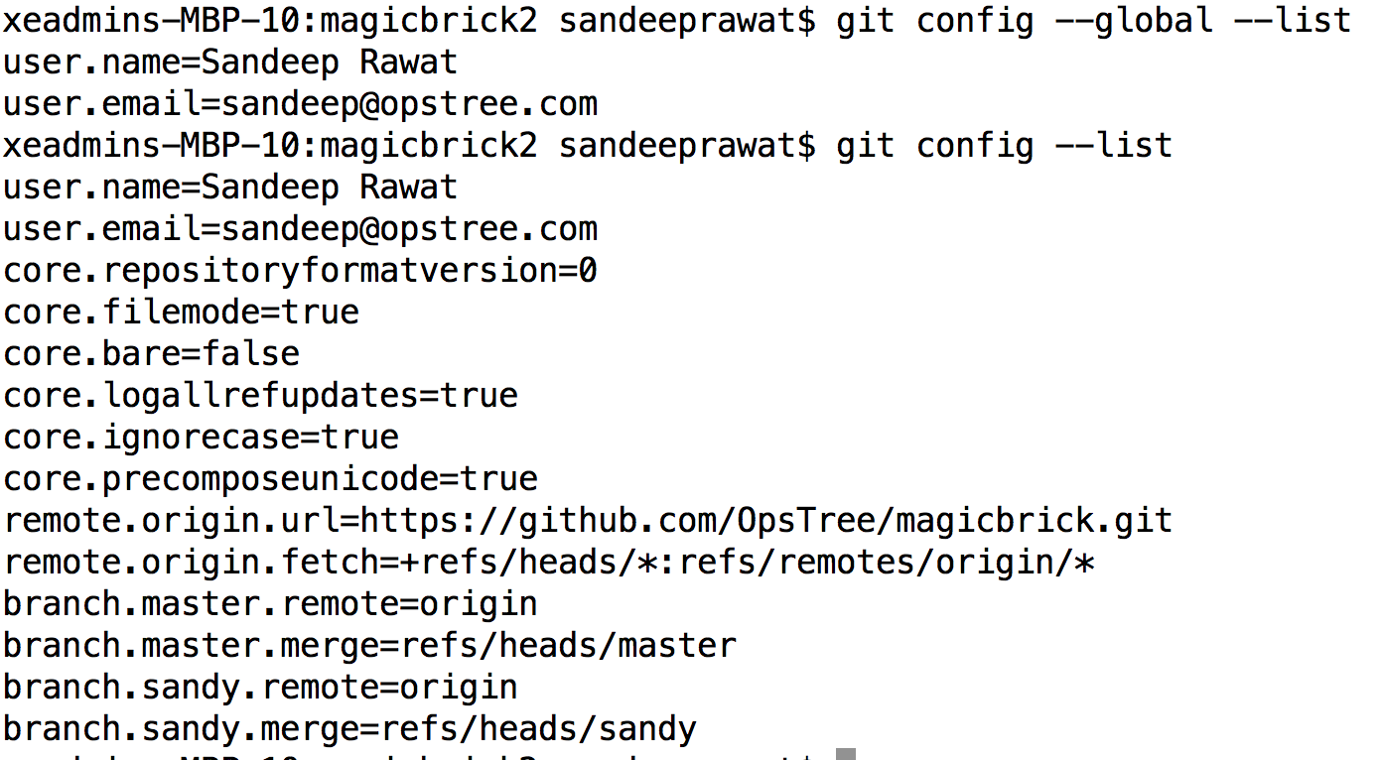
config
Used to set git configuration values on a global or local project level
This configuration level corresponds to .gitconfig text files
Notes:
https://git-scm.com/docs/git-stash

Slide 9
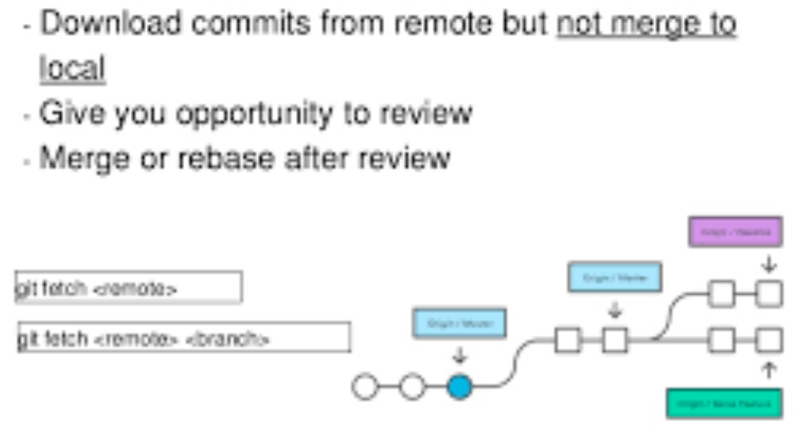
fetch
It is a part of syncing mechanism like pull, remote, push
Imports commit from remote repo to local repo
Fetch doesn’t merge the commits
Resulting commits are stored as remote branches instead of local branches
Notes:
https://git-scm.com/docs/git-stash

